Slide 1
Cables
In order for communication to occur a source, destination, and some sort of channel must be present.
There are two kinds of physical cable.
Metal cables, usually copper, have electrical impulses applied to them to convey information
Fiber optic cables, made of glass or plastic, use flashes of light to convey information.

Slide 2
Cable Specifications
Questions to ask?
What speeds for data transmission can be achieved using a particular type of cable?
  speed of transmission affected by conduit used
What kind of transmission is being considered?
  Digital or baseband transmission
  Analog-based or broadband transmission
How far can a signal travel through a particular type of cable before attenuation of that signal becomes a concern?

Slide 3
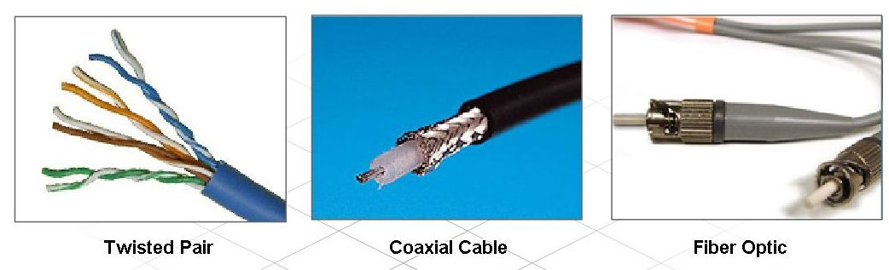
Types of Cables and Connectors Used in Networking
Identify and describe common types of cables

Slide 4
Twisted Pair
Modern Ethernet technology generally uses a type of copper cable known as twisted pair (TP) to interconnect devices.
Twisted pair cables consist of one or more pairs of insulated copper wires that are twisted together and housed in a protective jacket
There are three types of twisted pair cable: unshielded twisted pair, shielded twisted pair, and screened twisted pair.

Slide 5
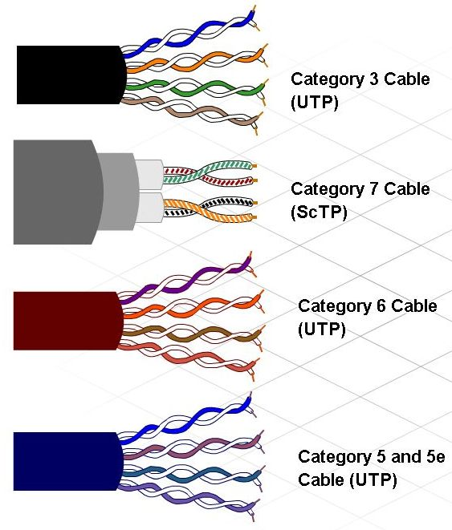
Types of Cables and Connectors Used in Networking
Describe twisted pair cables, common terminations, and when they are used

Slide 6
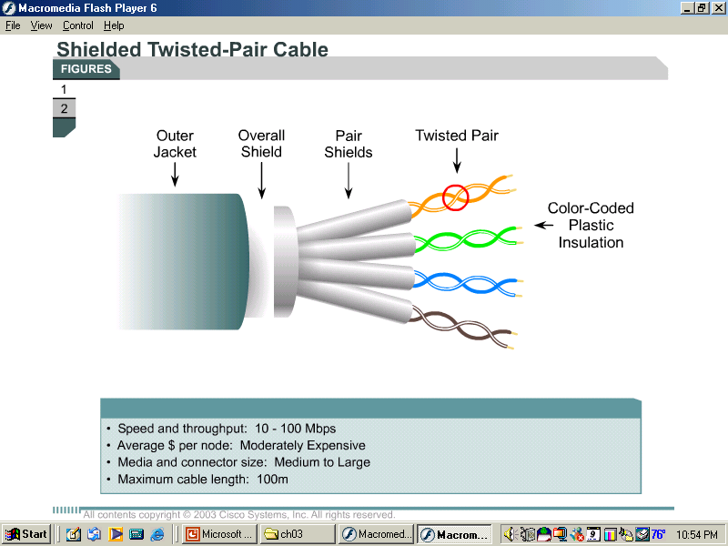
Shielded Twisted-Pair Cable
Shielded twisted-pair cable (STP) combines
  shielding
  cancellation
  twisting of wires
STP reduces electrical noise
  Crosstalk
  electromagnetic interference (EMI)
  radio frequency interference (RFI).

Slide 7
STP cable
STP affords greater protection from all types of external interference
Disadvantages:
  more expensive
  difficult to install than UTP

Slide 8
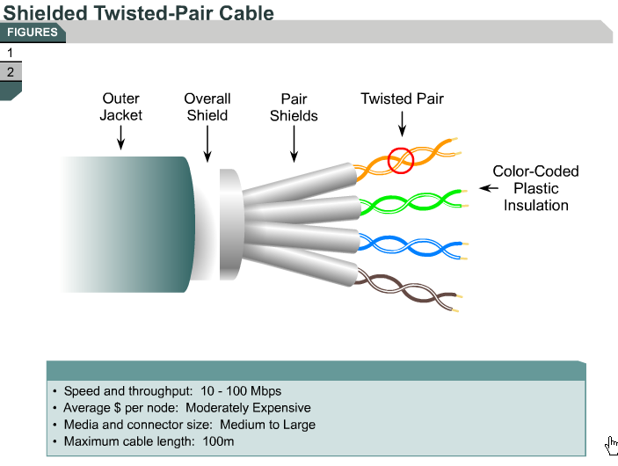

Slide 9
STP
The metallic shielding materials in STP and ScTP need to be grounded at both ends.
If improperly grounded or if there are any discontinuities:
  STP and ScTP can become susceptible to major noise problems.

Slide 10
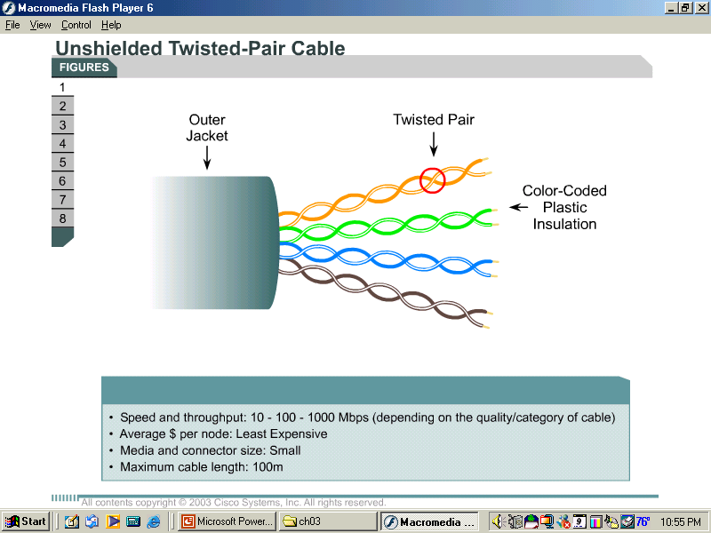
UTP Cable
Unshielded twisted-pair cable (UTP)
  4 pairs of wires
  Each wire covered by insulating material.
  Each pair of wires is twisted around each other.
  Number of Twists limits signal degradation caused by EMI and RFI.

Slide 11
UTP Cable
Advantages.
  It is easy to install
  less expensive than other types of networking media.
  However, the real advantage is the size of the cable
Disadvantages
  prone to electrical noise and interference
  shorter runs than coaxial and fiber optic cables

Slide 12
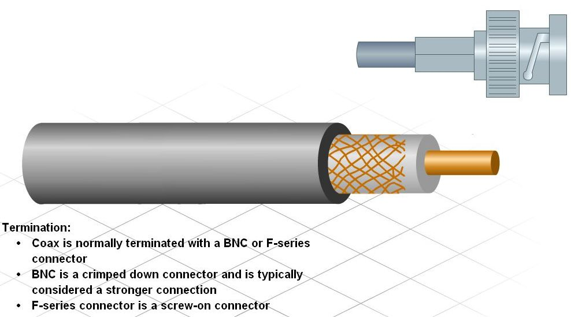
Types of Cables and Connectors Used in Networking
Describe Coax cable, common terminations, and when they are used

Slide 13
Coax cable
Like twisted pair, coaxial cable (or coax) also carries data in the form of electrical signals.
It provides improved shielding compared to UTP
It has a lower signal-to-noise ratio and can therefore carry more data.

Slide 14
Coaxial Cable
Coaxial cable
  hollow outer cylindrical conductor
  single inner wire conductor (usually copper)
Advantages:
  Run longer distances than STP & UTP without repeaters
  less expensive than fiber-optic cable
Disadvantages:
  more expensive to install than twisted-pair cable.
  Difficult to install- not as flexible due to thickness
  Used to be used for Ethernet backbone cable, because it has a greater transmission length and noise rejection characteristics.

Slide 15
Optical Fiber
Fiber optic cables transmit data using pulses of light
Fiber optic cable is constructed of either glass or plastic, neither of which conducts electricity.
It is immune to EMI and is suitable for installation in environments where interference is a problem.
Fiber optic cables support a large amount of bandwidth making them ideally suited for high-speed data backbones

Slide 16
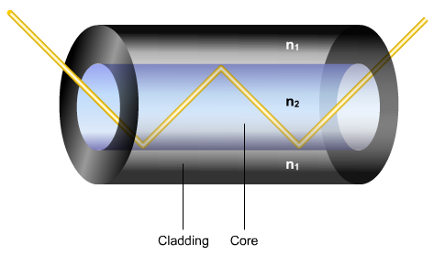
Optical fibre
Optical fibre is designed so that light is reflected back into the core by total internal reflection and is not lost into the cladding

Slide 17
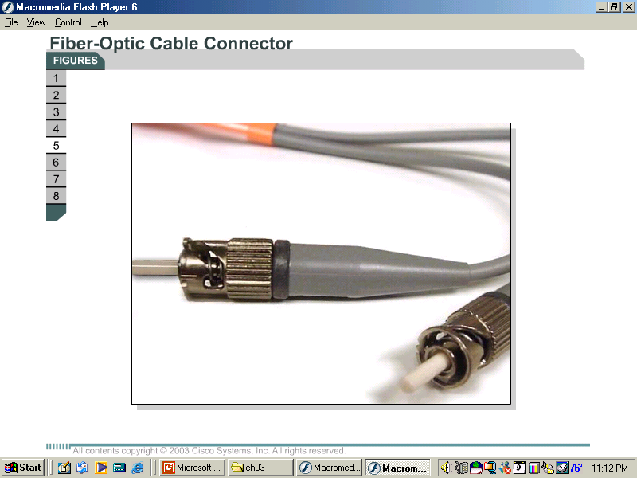
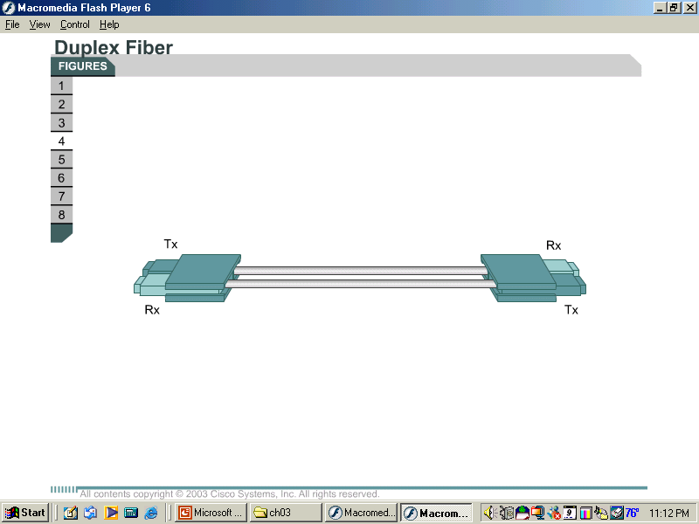
Fiber optic
2 glass fibers encased in separate sheaths
  One fiber carries transmitted data from device A to device B.
  The second fiber carries data from device B to device A.
    The fibers are similar to two one-way streets going in opposite directions.
Full-duplex communication link

Slide 18
Types of Fiber
Multimode Fiber
  diameter of the core of the fiber is large enough so that there are many paths that light can take through the fiber
Single-mode fiber
  smaller core
  light rays to travel along one mode

Slide 19
Multimode fiber (62.5/125)
Five parts make up each fiber-optic cable
  core
  cladding
  buffer
  strength material
  outer jacket
Carry data distances of up to 2000 meters (6,560 ft)
2 types of light source
  Infrared Light Emitting Diodes (LEDs)
  Vertical Cavity Surface Emitting Lasers (VCSELs)

Slide 20
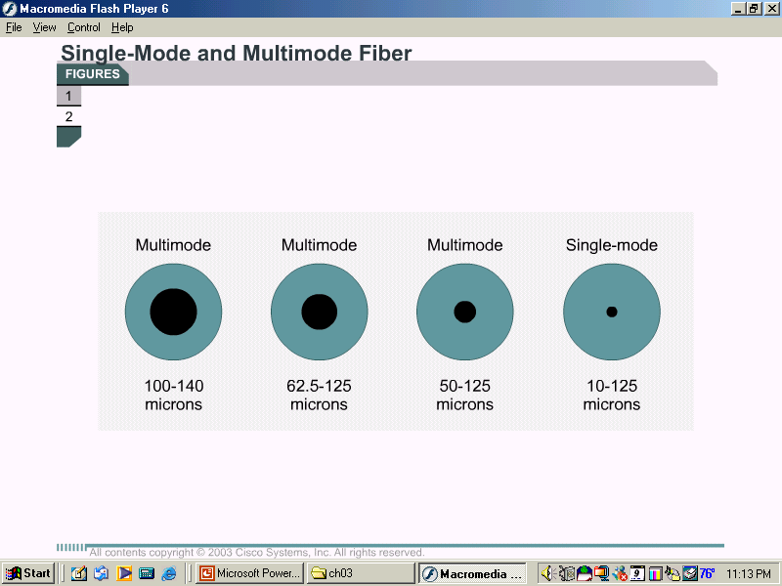
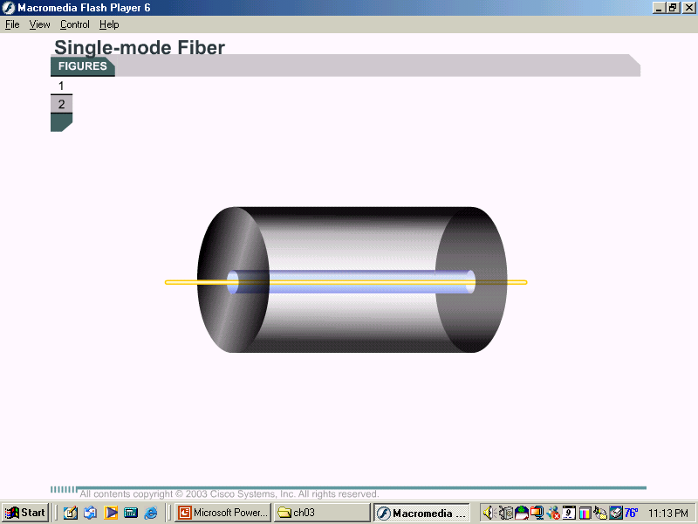
Single-mode Fiber
Single-mode fiber consists of the same parts as multimode.
core fiber has a diameter of 9 microns and the surrounding cladding is 125 microns in diameter.
infrared laser is used as the light source

Slide 21
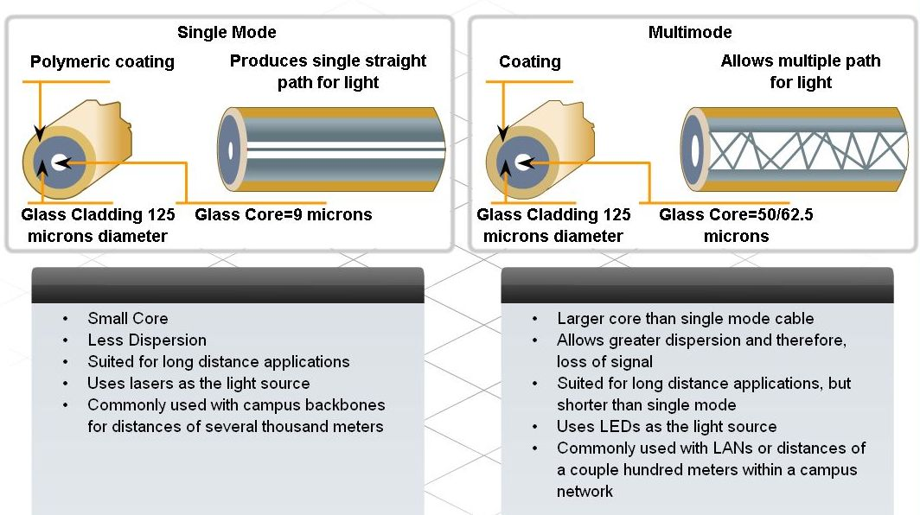
Types of Cables and Connectors Used in Networking
Describe optical fiber cables, common terminations, and when they are used

Slide 22
Multimode fiber (62.5/125)
Five parts make up each fiber-optic cable
  core
  cladding
  buffer
  strength material
  outer jacket
Carry data distances of up to 2000 meters (6,560 ft)
Light source
  Infrared Light Emitting Diodes (LEDs)

Slide 23
Single-mode Fiber
Single-mode fiber consists of the same parts as multimode.
core fiber has a diameter of 9 microns and the surrounding cladding is 125 microns in diameter.
infrared laser is used as the light source

Slide 24
Single-mode Fiber
major difference vs. Multi-mode fiber:
  single-mode allows only one mode of light to propagate through the smaller, fiber-optic core.
  3000 meters
  More expensive
  Used for inter-building connectivity

Slide 25
Single-mode Fiber
Warning: The laser light used with single-mode has a longer wavelength than can be seen. The laser is so strong that it can seriously damage eyes.
Never look at the near end of a fiber that is connected to a device at the far end.
Never look into the transmit port on a NIC, switch, or router. Remember to keep protective covers over the ends of fiber and inserted into the fiber-optic ports of switches and routers. Be very careful.

Slide 26
Transmission Devices
Optical fiber links use light to send data
  To convert light into electricity, you need a transmitter & receiver
There are 2 types of light sources used to encode and transmit the data through the cable
  LEDs
  LASERS

Slide 27
Signals & Noise in Optical Fibers
Advantages
  not affected by the sources of external noise
  no problem with crosstalk

Slide 28
Signals & Noise in Optical Fibers
Disadvantages
  Scattering
  Absorption
  Attenuation
  Dispersion

Slide 29
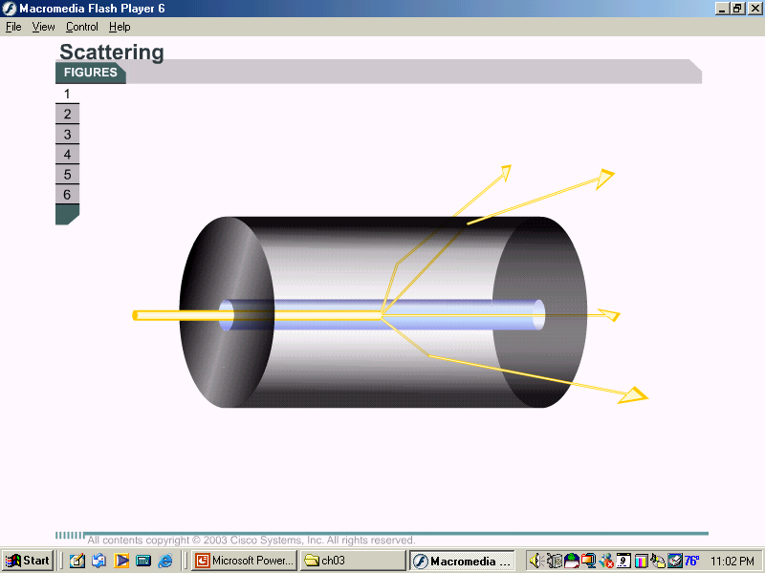
Scattering
Reflects and scatters some of the light energy

Slide 30
Scattering:
Caused by microscopic
distortions in the
fiber that scatters
some of the light.

Slide 31
Absorption
Caused by chemical impurities in the fiber that absorb some of the light energy
cause of light energy loss
  When a light ray strikes some types of chemical impurities in a fiber, the impurities absorb part of the energy.
  This light energy is converted to a small amount of heat energy.
  Absorption makes the light signal a little dimmer

Slide 32
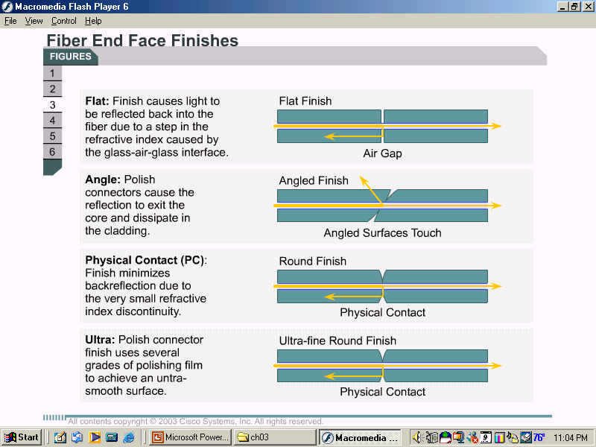
Attenuation
  Due to manufacturing irregularities or roughness in the core-to-cladding boundary

Slide 33
Manufacturing Roughness:
Power is lost because of
loss of total internal
reflection in the rough
area.

Slide 34
Dispersion
limits transmission distances on a fiber
  Dispersion is the technical term for the spreading of pulses of light as they travel down the fiber

Slide 35
Dispersion:
Spreading of pulses of
light as they travel
down a fiber.

Slide 36
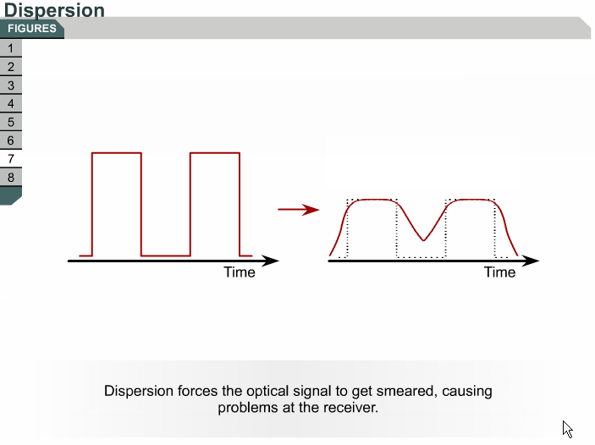

Slide 37
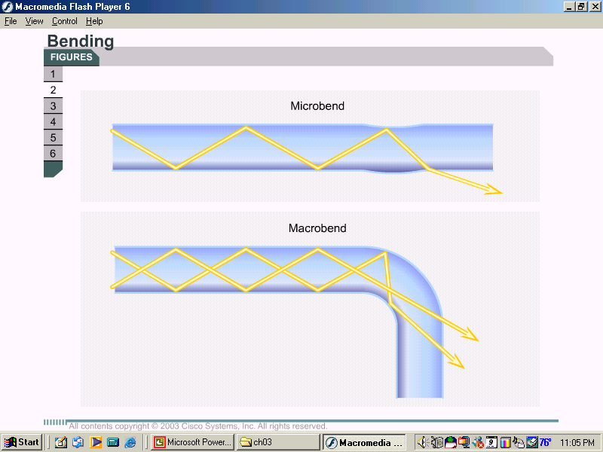
Installation, care, and testing of optical fiber
Too much attenuation
  improper installation.
Fiber stretched or curved too tightly
  cause tiny cracks in the core that will scatter the light rays.
  Bending the fiber changes the incident angle of light rays striking the core-to-cladding boundary
Connectors and the ends of the fibers must be kept spotlessly clean.

Slide 38
Installing Cable
After the fiber is pulled,
the ends are cut (cleaved)
and polished to make them
smooth.
Then the ends are examined
and the connector is attached.

Slide 39
Installation (continued)
The fiber ends should be
covered with protective
covers.
When the covers are removed,
the ends must be cleaned
with lens tissue and pure
isopropyl alcohol.

Slide 40
Fiber noise
Fiber noise- diminishes the strength of the light signal
Types of fiber noise
  Scattering
  absorption
  dispersion
  improper installation
  dirty fiber ends

Slide 41
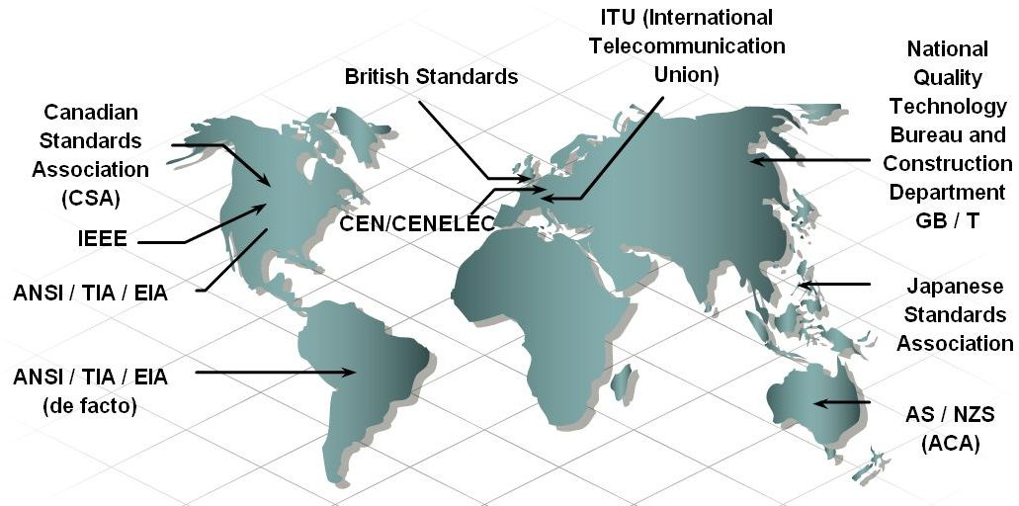
Construct and Terminate Twisted Pair Cables
Define cable standards and state their purpose

Slide 42
Working with twisted pair
Twisted pair cable is most commonly used in network installations
The TIA/EIA organization defines two different patterns, or wiring schemes, called T568A and T568B
Each wiring scheme defines the pinout, or order of wire connections, on the end of the cable.

Slide 43
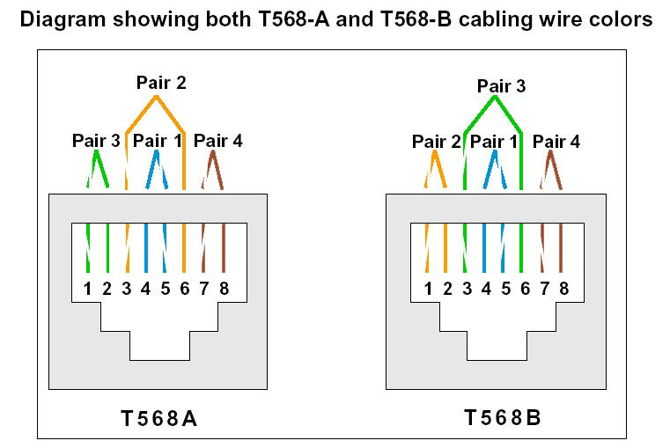
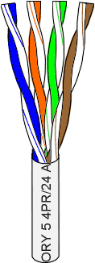

Slide 44
Two types of cables
Using the T568A and T568B wiring schemes, two types of cables can be created:
Straight-through
Crossover
The straight-through and crossover cables each have a specific use on the network.
The type of cable needed to connect two devices depends on which wire pairs the devices use to transmit and receive data.

Slide 45
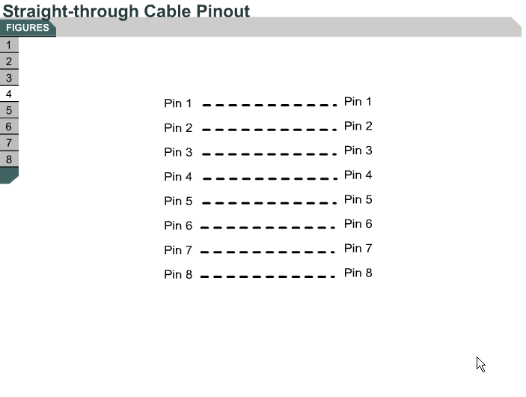

Slide 46
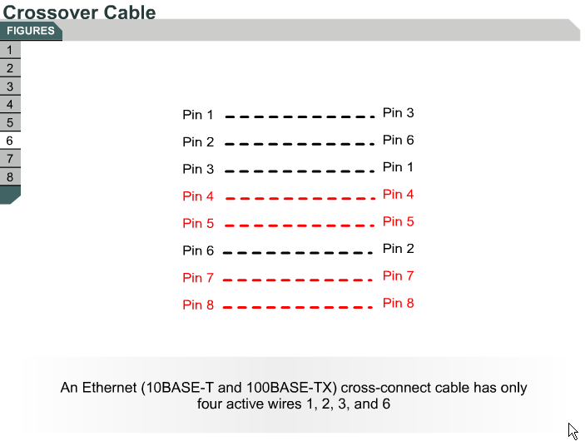

Slide 47
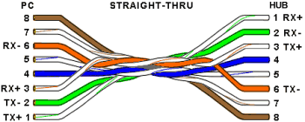
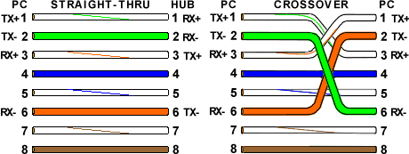

Slide 48
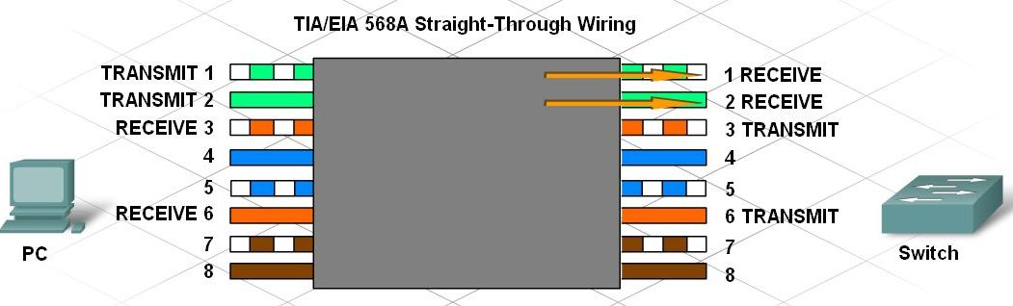
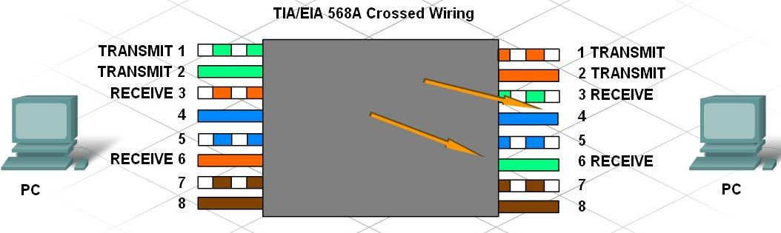
Construct and Terminate Twisted Pair Cables
Identify and describe the cross-over and straight through cable pinouts and color codes

Slide 49
Types of cables
Two devices directly connected and using different pins for transmit and receive are known as unlike devices.
They require a straight-through cable to exchange data
Devices that are directly connected and use the same pins for transmit and receive, are known as like devices.
They require the use of a crossover cable to exchange data.

Slide 50
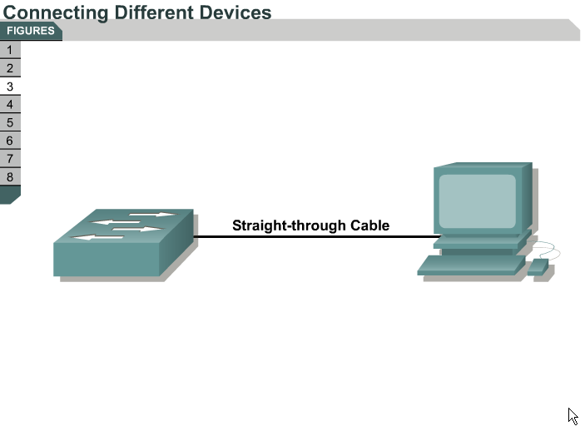

Slide 51
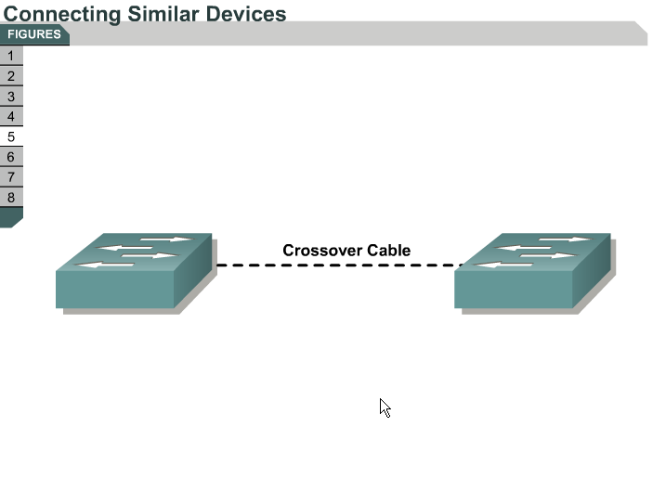

Slide 52
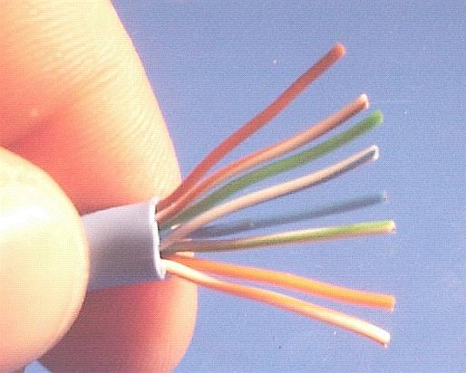

Slide 53
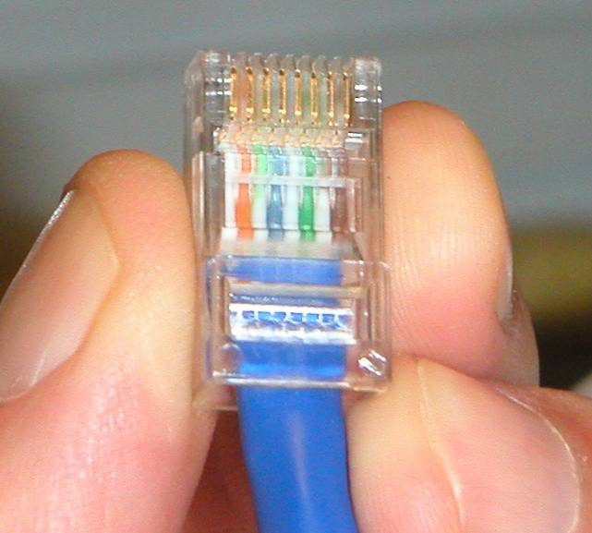

Slide 54
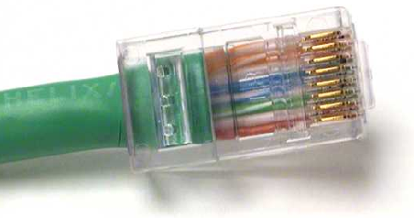

Slide 55
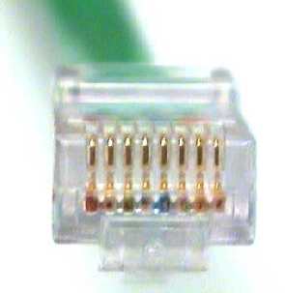

Slide 56
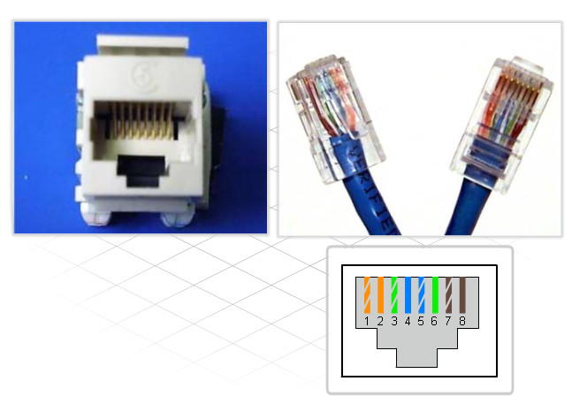
Construct and Terminate Twisted Pair Cables
Describe how to terminate UTP cables

Slide 57
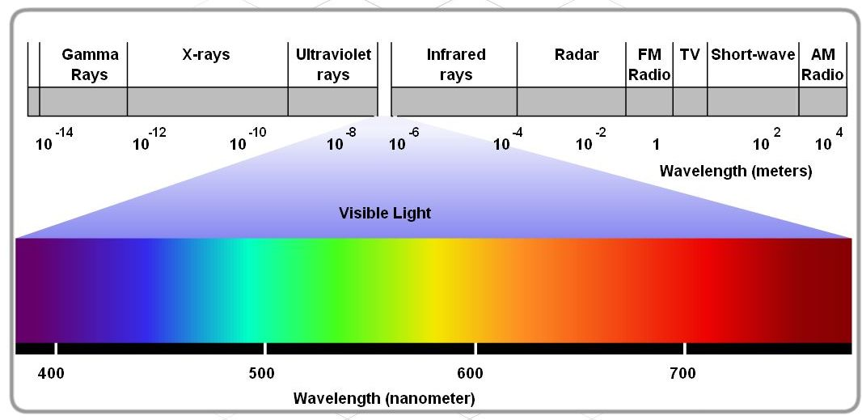
Wireless Technologies
The use of electromagnetic waves to carry information.
We call them “radio waves”
The most common wavelengths used for public wireless communications
  Infrared
  Radio Frequency
Electromagnetic
Spectrum

Slide 58
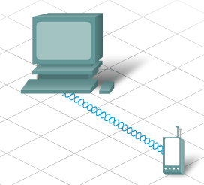
Infrared Technology
Low energy and unable to penetrate walls
It is generally used for short-range, line-of-sight, communications.
Unable to penetrate through walls
Used by:
  remote controls
  Used for PDAs, PCs, wireless mice, keyboards

Slide 59
Radio Frequency (RF) Technology
Goes through walls and other obstructions, better range
RF bands set aside for wireless devices, including cordless phones and computer peripherals
900 MHz – used by cell phones
2.4 GHz
  Bluetooth technology
  low speed, short range
  can communicate with many devices at once
5 GHz
  Wireless LAN
  transmit at a higher power level= greater distance
  conform to 802.11 standards

Slide 60
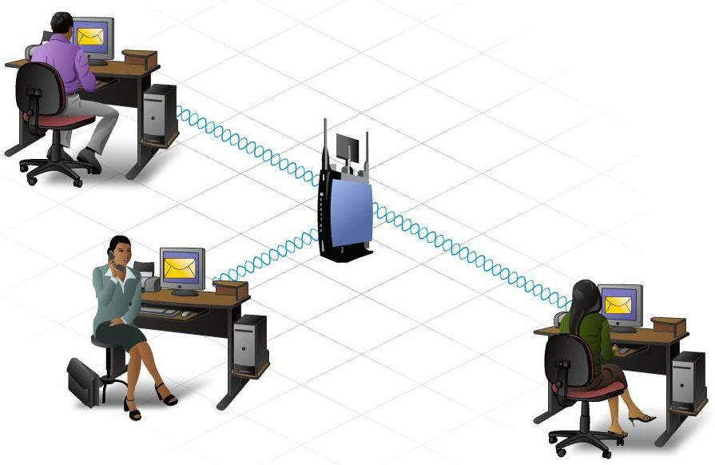
Wireless Technologies
Pros
  Anytime, anywhere connectivity with hotspots
  Easy and cheap installation
  Device prices dropping
  Data rate capabilities increasing
  Easy expansion
Cons
  Unlicensed RF which is crowded with other devices
    Bluetooth
    Microwaves
    Cordless phones
  Security is difficult because there is no way to limit who can intercept the wireless signal
    Encryption helps, but can be defeated
  Fluctuations in temperature and humidity can really affect transmission range.
Notes:
Wireless technology offers many advantages compared to traditional wired networks.
One of the main advantages is the ability to provide anytime, anywhere connectivity. The widespread implementation of wireless in public locations, known as hotspots, allows people to easily connect to the Internet to download information and exchange emails and files.
Wireless technology is fairly easy and inexpensive to install. The cost of home and business wireless devices continues to decrease. Yet, despite the decrease in cost, the data rate and capabilities of these devices have increased, allowing faster, more reliable wireless connections.
Wireless technology enables networks to be easily expanded, without the limitations of cabled connections. New and visiting users can join the network quickly and easily.
Despite the flexibility and benefits of wireless, there are some limitations and risks.
First, Wireless LAN (WLAN) technologies make use of the unlicensed regions of the RF spectrum. Since these regions are unregulated, many different devices make use of them. As a result, these regions are congested and signals from different devices often interfere with each other. In addition, many devices such as microwave ovens and cordless phones use these frequencies and can interfere with WLAN communications.
Second, a major concern with wireless is security. Wireless provides ease of access. It does this by broadcasting data in a manner that allows anyone the ability to access it. However, this same feature also limits the amount of protection wireless can provide for the data. It allows anyone to intercept the communication stream, even unintended recipients. To address these security concerns, techniques have been developed to help secure wireless transmissions including encryption and authentication.

Slide 61
Summary
The Internet is a worldwide collection of computer networks, accessed through ISPs.
Internet Protocol (IP) controls the structure and addressing of data packets for transport through the Internet cloud.
ISP Network Operations Centers (NOCs) utilize high-end, high-speed devices with redundancy.
Home networks feature multi-function devices which perform switching and routing.
Networks use physical cabling media which must conform to standards in construction and termination.
Cabling best practices are designed to reduce attenuation and crosstalk.

